Slide 1
Jungle Book:
The Adventures of Mowgli
Come Face to Face With Something
Wild and Wonderful!
A UNIQUE INDO-AMERICAN
DANCE PRODUCTION
AVAILABLE FOR TOURING IN INDIA IN
OCTOBER 2018

Slide 2
Highlights of the Production
Jungle Book: The Adventures of Mowgli, is a first-of-its-kind cross-cultural dance production that was presented with Bharatanatyam and Ballet dancers in 1996-97
Based entirely on the book by Rudyard Kipling
Won Northern Ohio Live best dance production award for 1996-1997
Performed over 100 shows across USA in 1996-97
Originally performed by Bharatakalanjali led by Dhananjayans and the Ohio Ballet led by Heinz Poll
Large-scale stage production with exquisite music, aesthetic lighting, set and costume design

Slide 3
Artistic Team

Slide 4
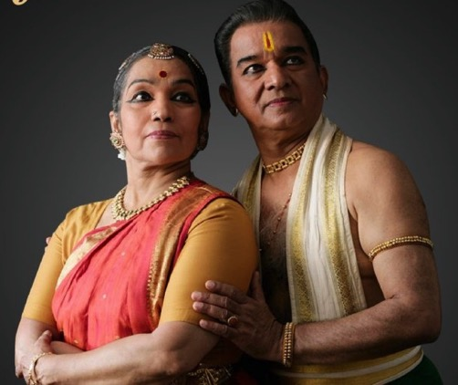
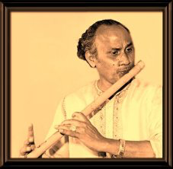
The Padmabhushan awardees (a high honour given by the Government of India), Shanta & V.P. Dhananjayan are internationally renowned dancers and teachers, with several decades in the field of performing arts.
Bharatakalanjali, the 50-year old dance academy established by Dhananjayans is one of the foremost dance institutes in India.
Dhananjayans
Late Pandit Vijay Raghav Rao is a renowned flautist, choreographer, conductor, poet and musicologist. He has worked extensively with Pandit Ravi Shankar.
The story of Mowgli in the dance production is told through splendid sounds of North and South Indian music composed by this legendary flautist.
Vijay Raghav Rao

Slide 5
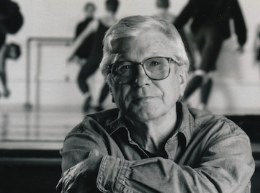
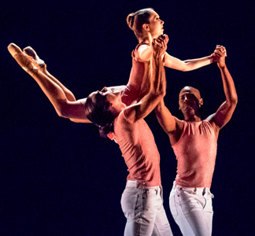
The late Heinz Poll was the choreographer and a co-founder of the Ohio Ballet. He had a dance career that spanned between 1947 – 2006, Poll was one of the most accomplished dancers of his times.
Heinz Poll along with the Dhananjayans was the artistic director of the Jungle Book production.
Heinz Poll
The Verb Ballets, USA is a contemporary ballet company, that presents dynamic programing through bold artistry, unique styles and technical excellence
For the 2018 tour, The Verb Ballets, will be a part of the Jungle Book Production
Verb Ballets

Slide 6
Dr. Margaret Carlson, Producing Artistic Director of Verb Ballets, has worked internationally in performing, teaching, choreographing, and in arts administration. Dr. Carlson was an original member of the Cleveland Ballet, serving as a Principal dancer from 1972-1983. She performed in numerous musical theatre tours throughout the 1970’s, including Brigadoon, Hello Dolly! and The Merry Widow, to name a few.
Dr. Margaret Carlson
Richard Dickinson is the Artistic Associate of Verb Ballets. He was in the original production of “Jungle Book” in 1997 when he was the ballet master and a principal dancer with Ohio Ballet. He worked closely with Heinz Poll and V.P. Dhananjayan in creating the dances and interpreting the major role of the Wolf Akela.
Choreography for 2018 presentation has been refreshed by Richard, inspired by the original choreography by Heinz Poll.
Richard Dickinson

Slide 7
THe Producers

Slide 8
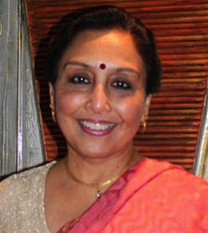
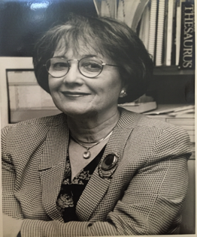
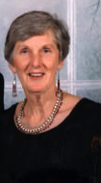
Cleveland Cultural Alliance (CCA) founded by Uma Ganesan, is a non-profit organisation established in the US and in India. It has been committed to the idea that dance - professionally produced and passionately realized - is a universal language that bridges all cultures and generations.
Dr Lucille Gruber, retired as the Director, The Office of Cultural Arts, Cuyahoga Community College has presented a wide array of cultural programs at the three campuses of the college.
Barbara S. Schubert’s association with the Ohio Ballet started in 1973. In 1987 she became the company’s sixth General Manager. In 1993 the Board of Trustees honored Mrs. Schubert by awarding her the annual BRAVO award for her contributions.
Uma Ganesan
Lucille Gruber
Barbara Schubert

Slide 9
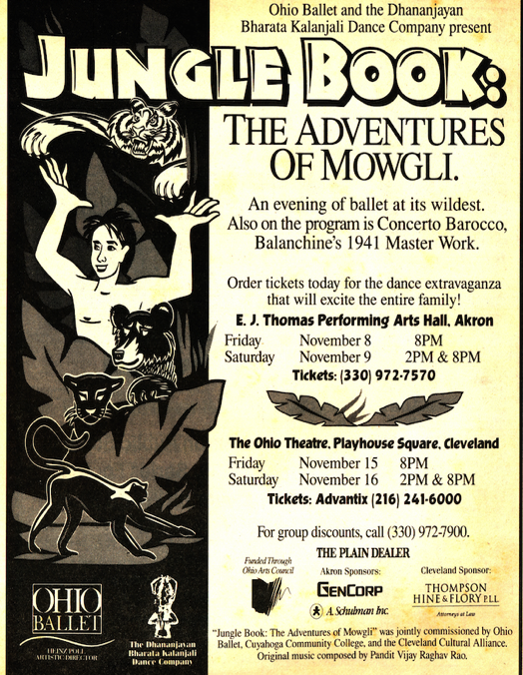
Jungle Book was co-commissioned and produced by Cleveland Cultural Alliance (CCA), Ohio Ballet and Cuyahoga Community College (TRI-C)
Uma Ganesan of CCA and Lucille Gruber of TRI-C have been instrumental in bringing together Bharatanatyam and Ballet, to create a unique production that resonates across ages and cultures.
Jungle Book will be produced and presented for the first time in India by Cleveland Cultural Alliance (India)
Lucille Gruber
Barbara Schubert,

Slide 10
Press Reviews

Slide 11
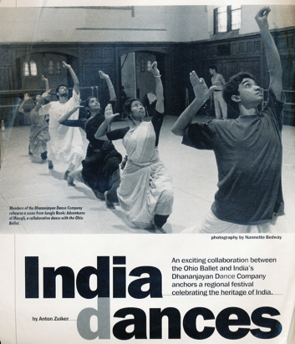
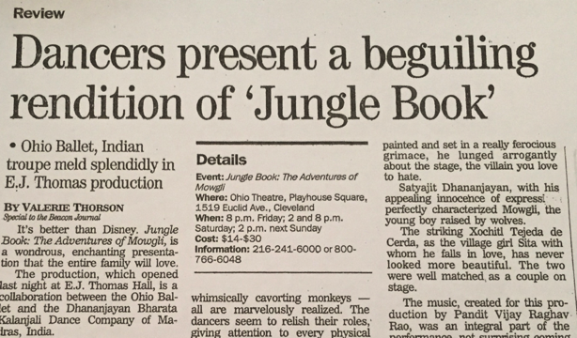
“Timeless Jungle book movingly choreographed, wonderfully performed”,
Cleveland Plain Dealer, Willma Salisbury
"Reflective music, refreshing and genuinely haunting..."
The New York Times
“And here the really exceptional costumes created by A. Christina Giannini, are a great contributing factor. They are remarkable and some of the best you will ever see in a theatrical production”
Valerie Thorson, Akron Beacon Journal

Slide 12
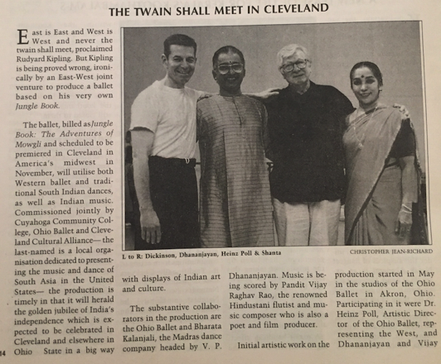
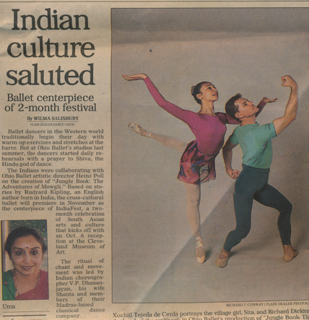
"Poll has surrounded himself with first-rate talent which makes every detail of Ohio Ballet's productions glow with a thoroughly professional sheen.”
Boston Globe
“The work has soul and that is what catches the attention of the viewer”
Leela Venkatraman, Sruti Magazine
"No substitute for his flute. The complete master..."
The Hindustan Times

Slide 13
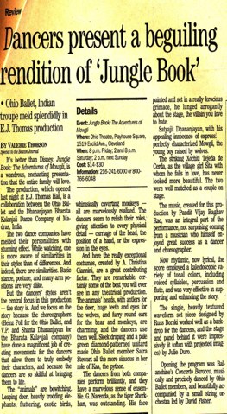
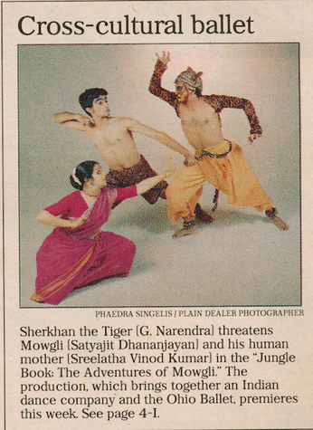
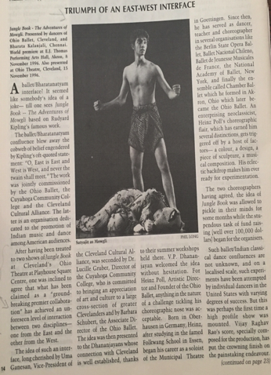
After having been treated to two shows of Jungle book, at Cleveland's Ohio Theatre at Playhouse Square Centre, one was inclined to agree that what has been claimed as a ground-breaking premier collaboration has achieved an unforeseen level of interaction between two disciplines – one from the east and the other from the west.
Triumph of an east-west interface
Leela Venkatraman, Sruti Magazine

Slide 14
Ganesan approached Schubert and Gruber with an idea for an international collaboration that would marry the classical dance of India with classical ballet of the west. They loved the idea, but it took some convincing before Poll and the Dhananjayans agreed to undertake the formidable task of merging the very different styles, in the adaptation of Rudyard Kipling’s famous story.
Northern Ohio Magazine awarded Jungle Book: The Adventures of Mowgli, the best production award for the year 1996-97
The result was stunning and gave audiences - many new to ballet - a fascinating look at two distinct dance traditions that was a sheer joy to watch.
Northern Ohio Live Magazine

Slide 15
Glimpses from the production

Slide 16
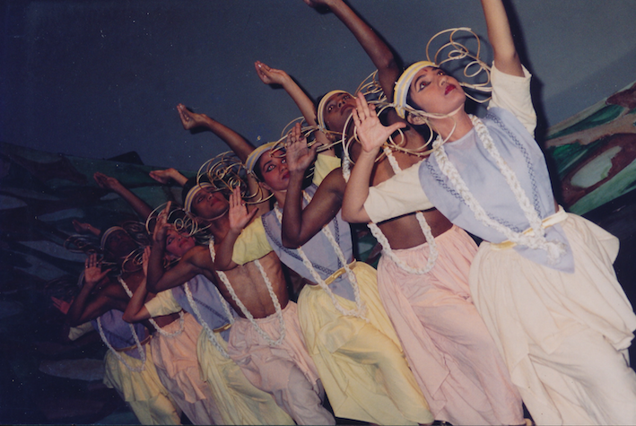

Slide 17
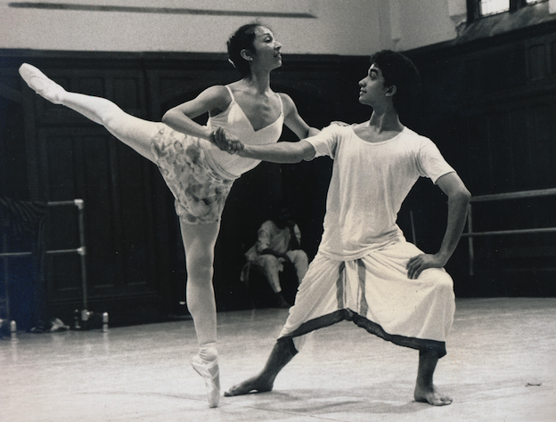

Slide 18
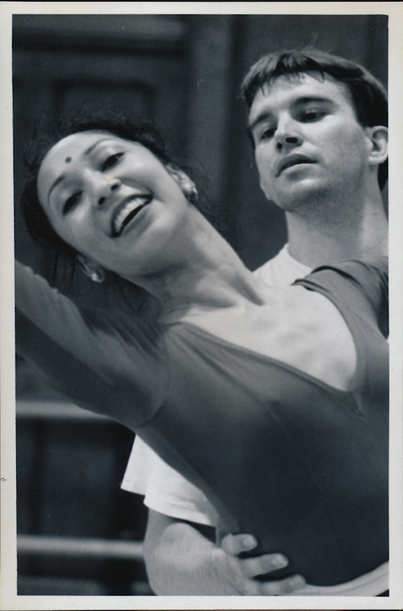
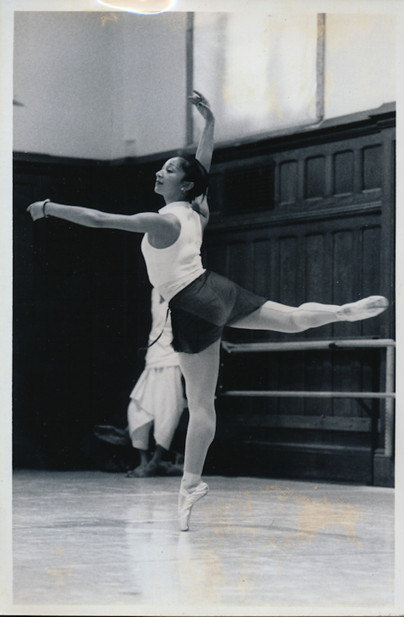

Slide 19
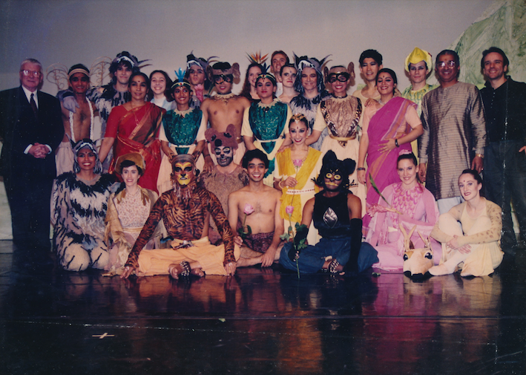

Slide 20
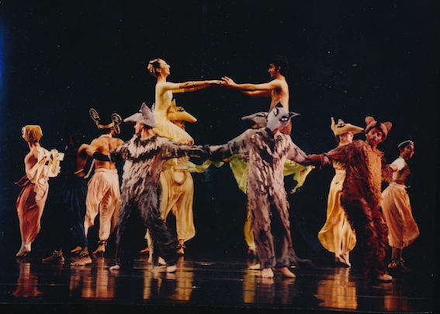

Slide 21
Presenting Jungle book: THE ADVENTURES OF MOWGLI dance PRODUCTION TOURING in India: October 2018

Slide 22
Dance Production in India
Jungle Book: The Adventures of Mowgli, is a story everyone loves across ages.
You will marvel at the mix as two cultures join together for the first time ever to produce a breath-taking extravaganza of music and dance with costumes and sets that bring Jungle Book to life, which the Indian audience must see.
6 city tour of India covering – Chennai, Bangalore, Mumbai, Kolkata, Delhi & Hyderabad
Multiple shows in each city
Shows will be ticketed for public
Estimated event footfalls will be approximately 5000 per city

Slide 23
Sponsor Benefits
Ability to create the desired brand positioning amongst the target audience
Direct access to both existing and potential target audience
Opportunity to display and showcase products
Creation of brand awareness and re-call
Generate goodwill, brand equity, by way of associating with this unique event and supporting a first-of-its kind artistic presentation in India

Slide 24
Marketing Plan
Digital Media
The Jungle Book Facebook Page will be an important vehicle of communication for event information, campaigns, program updates, sponsorship information and links.
Targeted online ad campaigns will be run across cities, create awareness about the event and drive ticket sales
This will also be an effective platform to convey sponsor messages and create engagement with the target audience.
Radio and Print Media
Tie-ups with local radio channels across each city to ensure the reach of the event
Advertising across print and other outdoor media that provides visibility across the city
Posters and brochures will be displayed in key locations – restaurants, cafes, children play areas, book stores etc
On-Ground Event Promotions
Branding across all event communications and promo materials
Activities for the audience based on the specific brand requirement

Slide 25
THANK YOU

